Slide 1
Gesture Controlled UI/UX Navigation Using Neural Networks
Rajat Bisht
Khoury College, Northeastern University

Slide 2

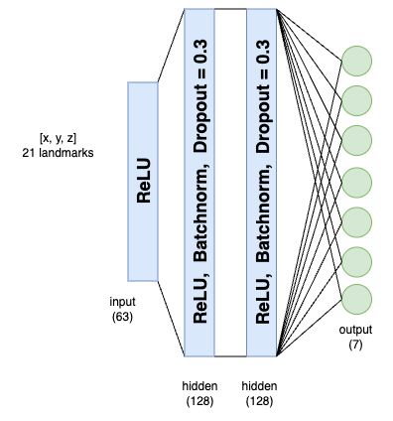
- Gesture Recognition Engine
Camera feed
(video)
0: Not A Gesture
Palm detection model
1: Track mouse pointer
2: Execute Left Click
3: Execute Double Click
4: Scrolling Window
Hand Landmark model
5: Execute Right Click
6: Scroll Switch Screen
Demo Window
MediaPipe Hands Library
Feed Forward Net

Slide 3
- Baseline and Implemented Improvement
Baseline 1:
Hand Gesture Recognition for Human Computer Interface[1]
Uses single camera to capture individual gesture images.
Utilized image processing algorithms to implement
Segmentation
Orientation detection
Feature extraction
Classification
Tested on 390 images
Avg. Accuracy = 92.3%
Avg. Detection Time = 2.76s
Published in 2011
Baseline 2:
Hand Gesture Recognition using Machine Learning Algorithms[2]
Uses single Kinect 3D camera to record gesture images at 20 fps.
Utilized machine learning algorithms to implement
Hand detection using histogram clustering
Classification using 3D-CNN
Human computer Interaction(HCI)
Detection distance = 30 - 10 cm
Avg. Accuracy = 85.83%
Published in 2020
Implemented Improvements:
Gesture Controlled UI/UX Navigation Using Neural Networks
Uses webcam video feed to detect gestures at 30fps.
Utilized neural networks to implement
Hand landmark tracking using MediaPipe-Hands[3] library
Classification using Feed-Forward Network
All Mouse operations (HCI) implemented using PyAutoGUI library.
Tested on 1387 images
Avg. Accuracy = 94.30%
Avg. Detection Time = 0.000819 sec
[1] Panwar, M., & Mehra, P. S. (2011, November). Hand gesture recognition for human computer interaction. In 2011 International Conference on Image Information Processing(pp. 1-7). IEEE.
[2] Abhishek, B., Krishi, K., Meghana, M., Daaniyaal, M., & Anupama, H. S. (2020). Hand gesture recognition using machine learning algorithms. Computer Science and Information Technologies, 1(3), 116-120.
[3] Zhang, F., Bazarevsky, V., Vakunov, A., Tkachenka, A., Sung, G., Chang, C. L., & Grundmann, M. (2020). Mediapipe hands: On-device real-time hand tracking. arXiv preprint arXiv:2006.10214.

Slide 4
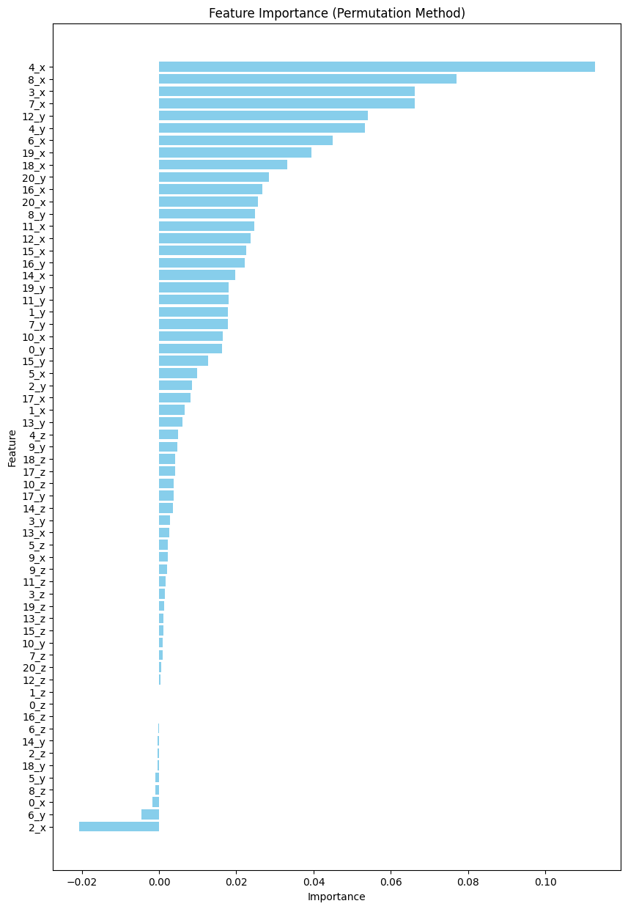
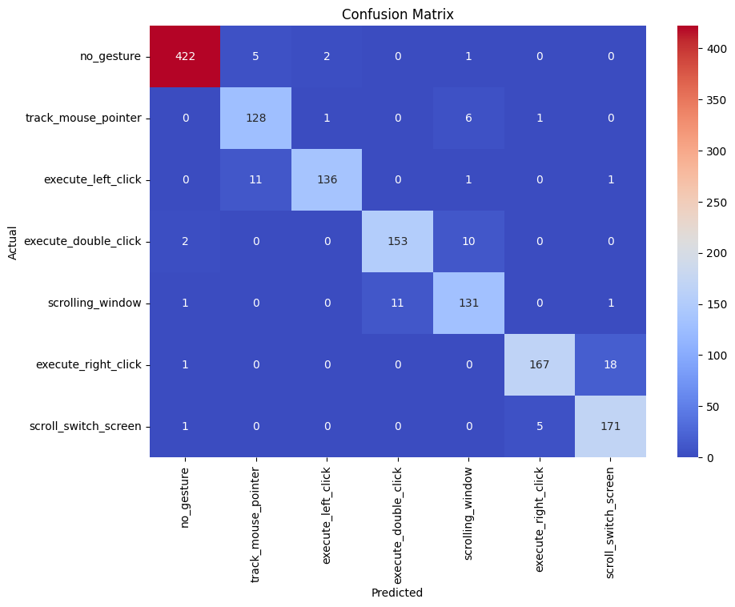
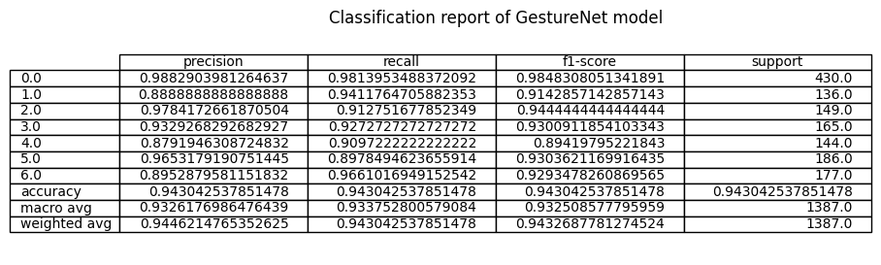
- Empirical Results

